Slide 1
Prepared by Ali Abbas

Slide 2
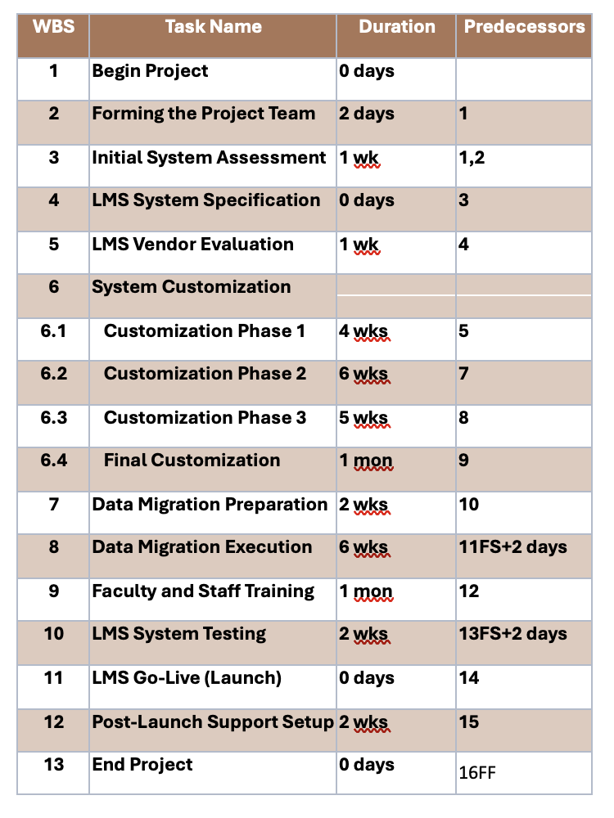
Work Breakdown Structure

Slide 3
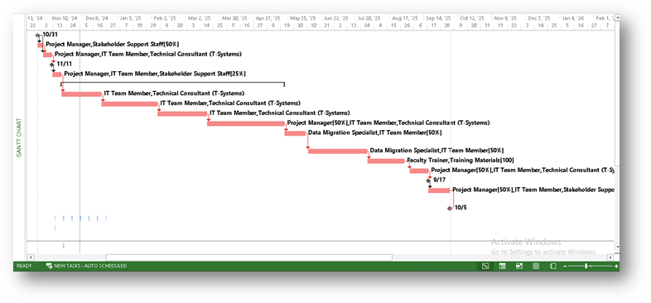
Gantt Chart

Slide 4
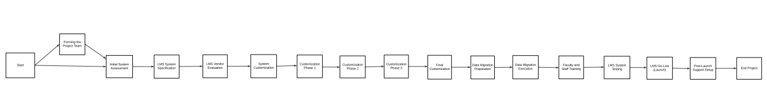
Network Diagram

Slide 5
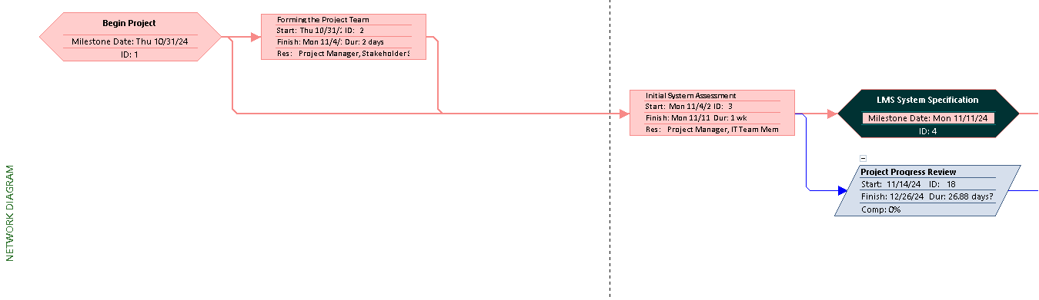
MS Network Diagram

Slide 6
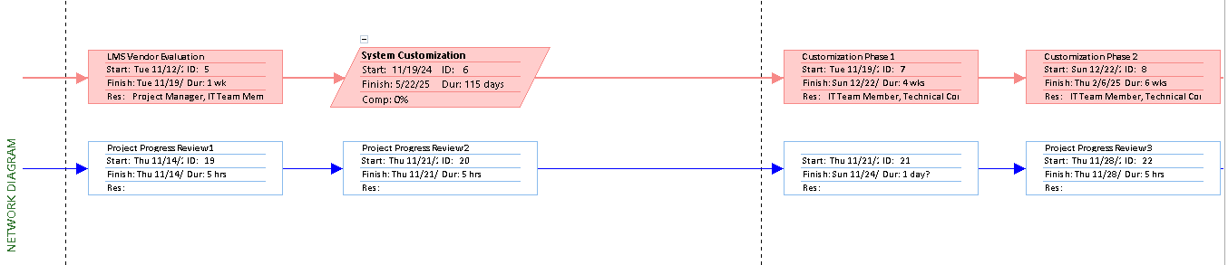

Slide 7
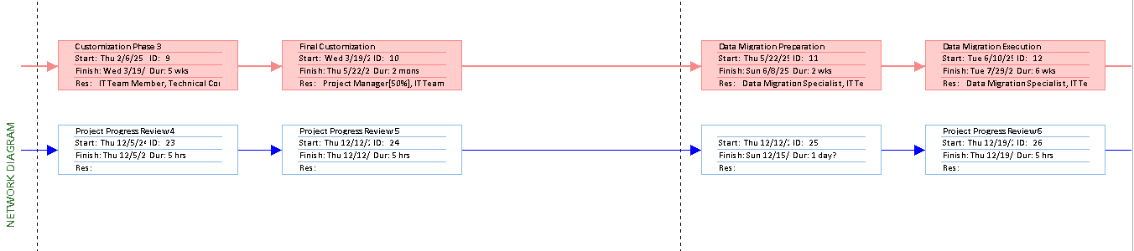

Slide 8
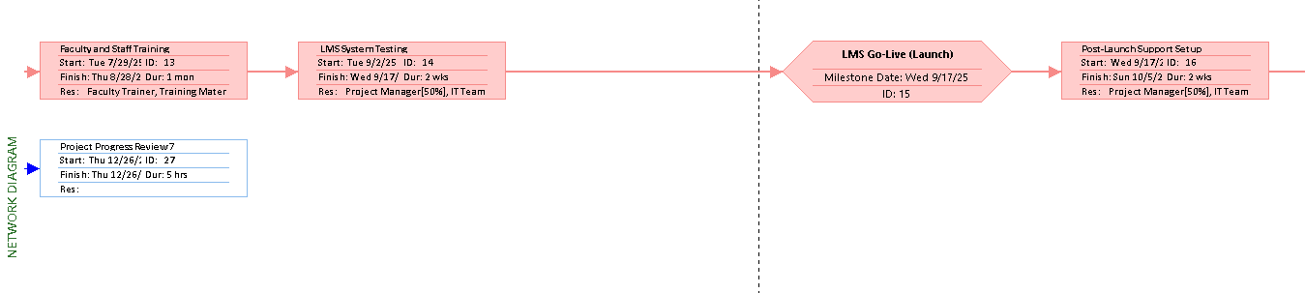

Slide 9
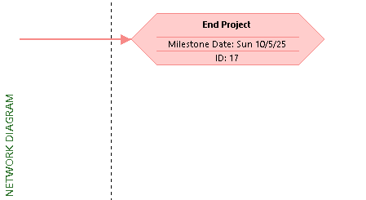

Slide 10
Cost Estimate
WBS items | 1 | 2 | 3 | 4 | 5 | 6 | 7 | 8 | 9 | 10 | 11 | 12 | Totals
1. Human Resources
Project manager | 1500 | 1500 | 1500 | 1500 | 1500 | 1500 | 1500 | 1500 | 1500 | 1500 | 1500 | 500 | 17000
IT Team Member | 1000 | 1000 | 1000 | 1000 | 1000 | 1000 | 1000 | 1000 | 1000 | 1000 | 1000 | 1000 | 12000
Faculty Trainer | 700 | 700 | 700 | 700 | 700 | 700 | 700 | 700 | 700 | 700 | 700 | 700 | 8400
Data Migration Specialist | 1500 | 1500 | 1500 | 1500 | 1500 | 1500 | 1500 | 1500 | 1500 | 1500 | 1000 | 1000 | 17000
Technical Consultant (T-Systems) | 800 | 800 | 800 | 800 | 800 | 800 | 800 | 800 | 800 | 800 | 800 | 800 | 9600
Stakeholder Support Staff | 850 | 850 | 850 | 850 | 850 | 850 | 850 | 850 | 850 | 850 | 850 | 850 | 10200
2.Equipments&Task
Learning Management System Software | 18000 |  |  |  |  |  |  |  |  |  |  |  | 18000
Training Materials |  |  |  | 3400 |  |  |  |  |  |  |  |  | 3400
University IT Equipment | 4400 |  |  |  |  |  |  |  |  |  |  |  | 4400
Totals | 28750 | 6350 | 6350 | 9750 | 6350 | 6350 | 6350 | 6350 | 6350 | 6350 | 5850 | 4850 | 100000

